Slide 1
docket
Assignment 5: Low-fi Prototyping
Irene Hsu, Ke Xu, Jessica Zhang

Slide 2
Overview
“Bringing ideas to life”
For people of all demographics and career paths, the bustle of everyday life leaves little time and energy for personal side projects.
Docket is a public platform that tracks the progress of projects and allows users to support one another’s projects for inspiration and motivation. Through documentation and social interaction, docket aims to keep users accountable for the success of their own and of others’ projects.

Slide 3
Value Proposition: “Ideas coming to life”
docket is a public platform that helps document the progress of projects. By updating a project docket, looking through others’ projects and interacting with users, anyone can keep track of his/her progress and stay motivated.

Slide 4
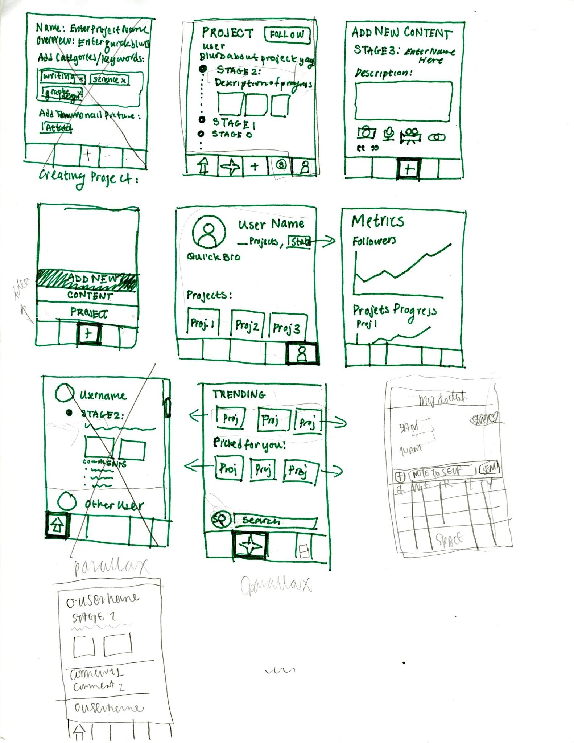
Selected Interface
& Rationale

Slide 5
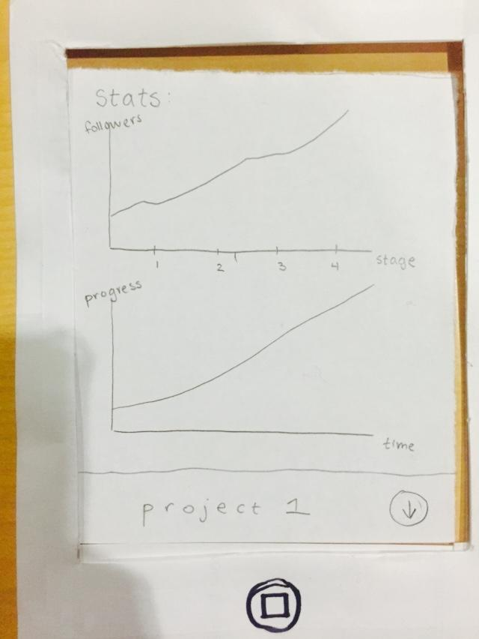
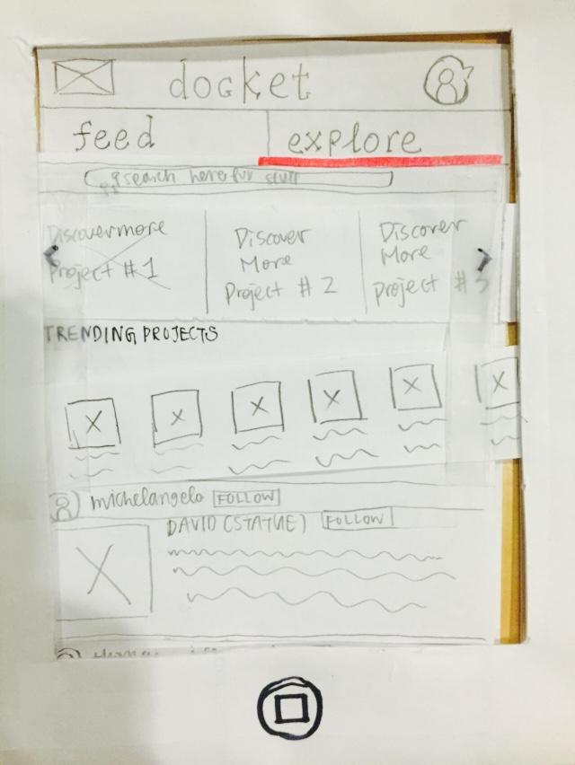
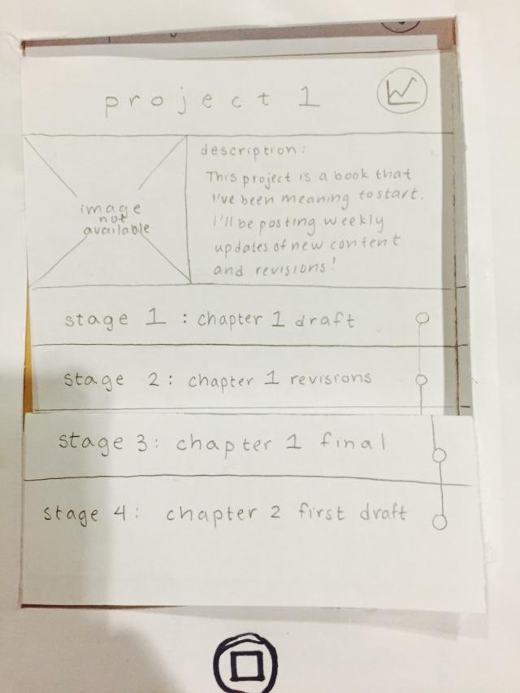
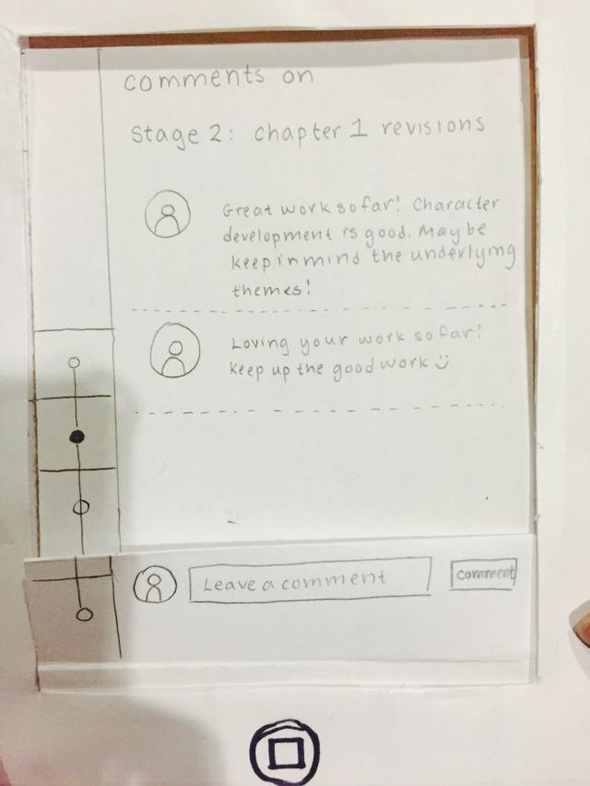
Selected Interface & Rationale
swipe
Tasks are interrelated
Notes:
We believe swipe connects the tasks, and it maximize the screen.
Button at bottom for a lot of apps has to categorize their function, and our tasks are interrelated.

Slide 6
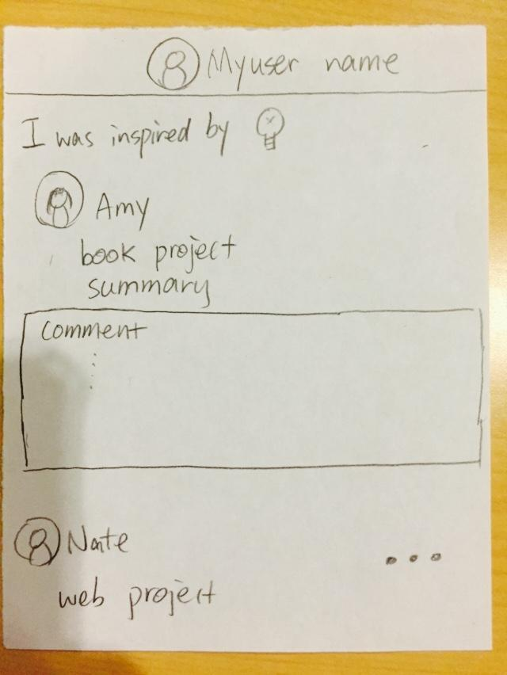
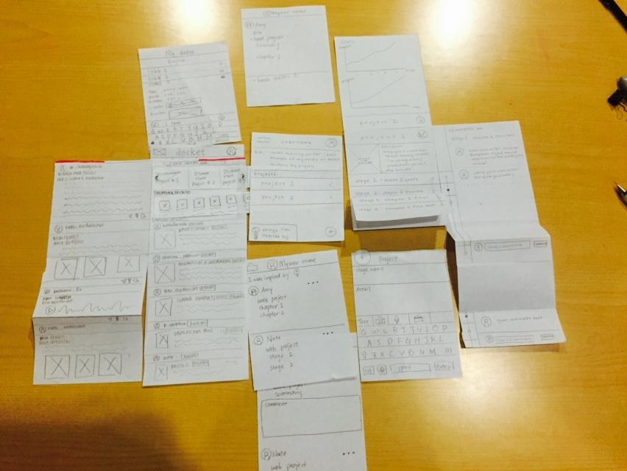
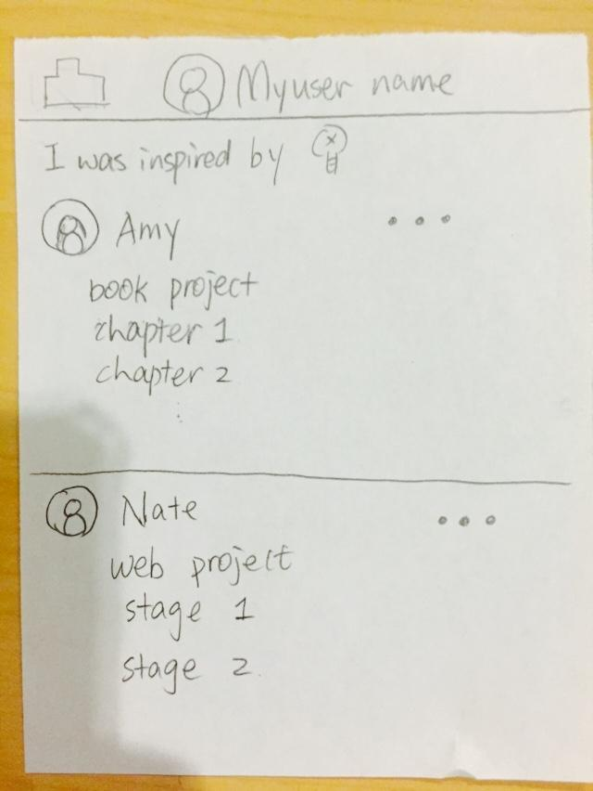
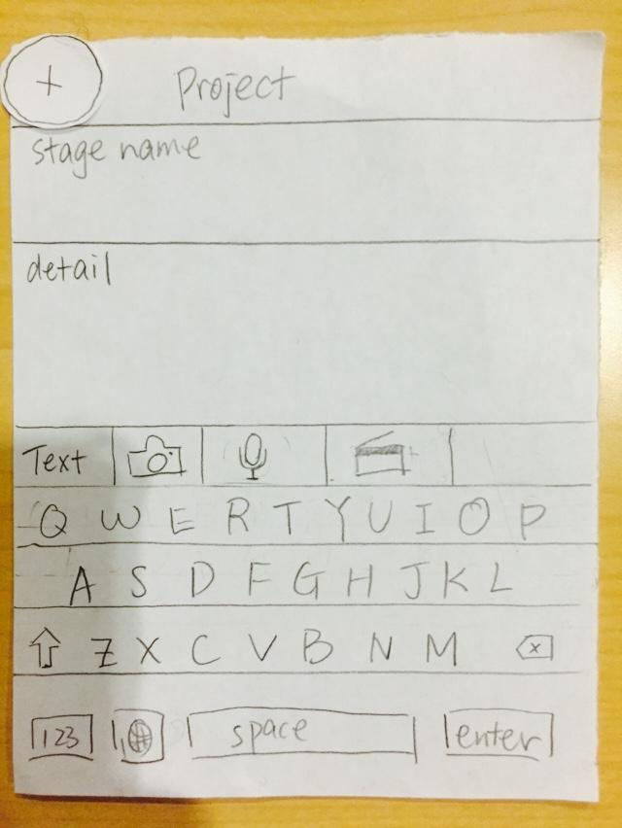
Low-fi prototype Structure
Feed\ Explore page to look for inspiration
My project page to manage and document my project
Check comments to stay motivated
Check the project you were inspired by

Slide 7
Three Tasks & Sub-Tasks
Users come to look for inspiration.
(navigate feed, like posts, being inspired by posts, check the posts they were inspired by, explore projects, look through trending projects, follow a project)
Users come to look for/give motivation.
(view the statistics on their own project, check the comments on a stage of their project, leave a comment on a stage of someone else’s comment)
Users come to document their project.
(add a quick note to themselves, create a new project, create a new stage on the project)

Slide 8
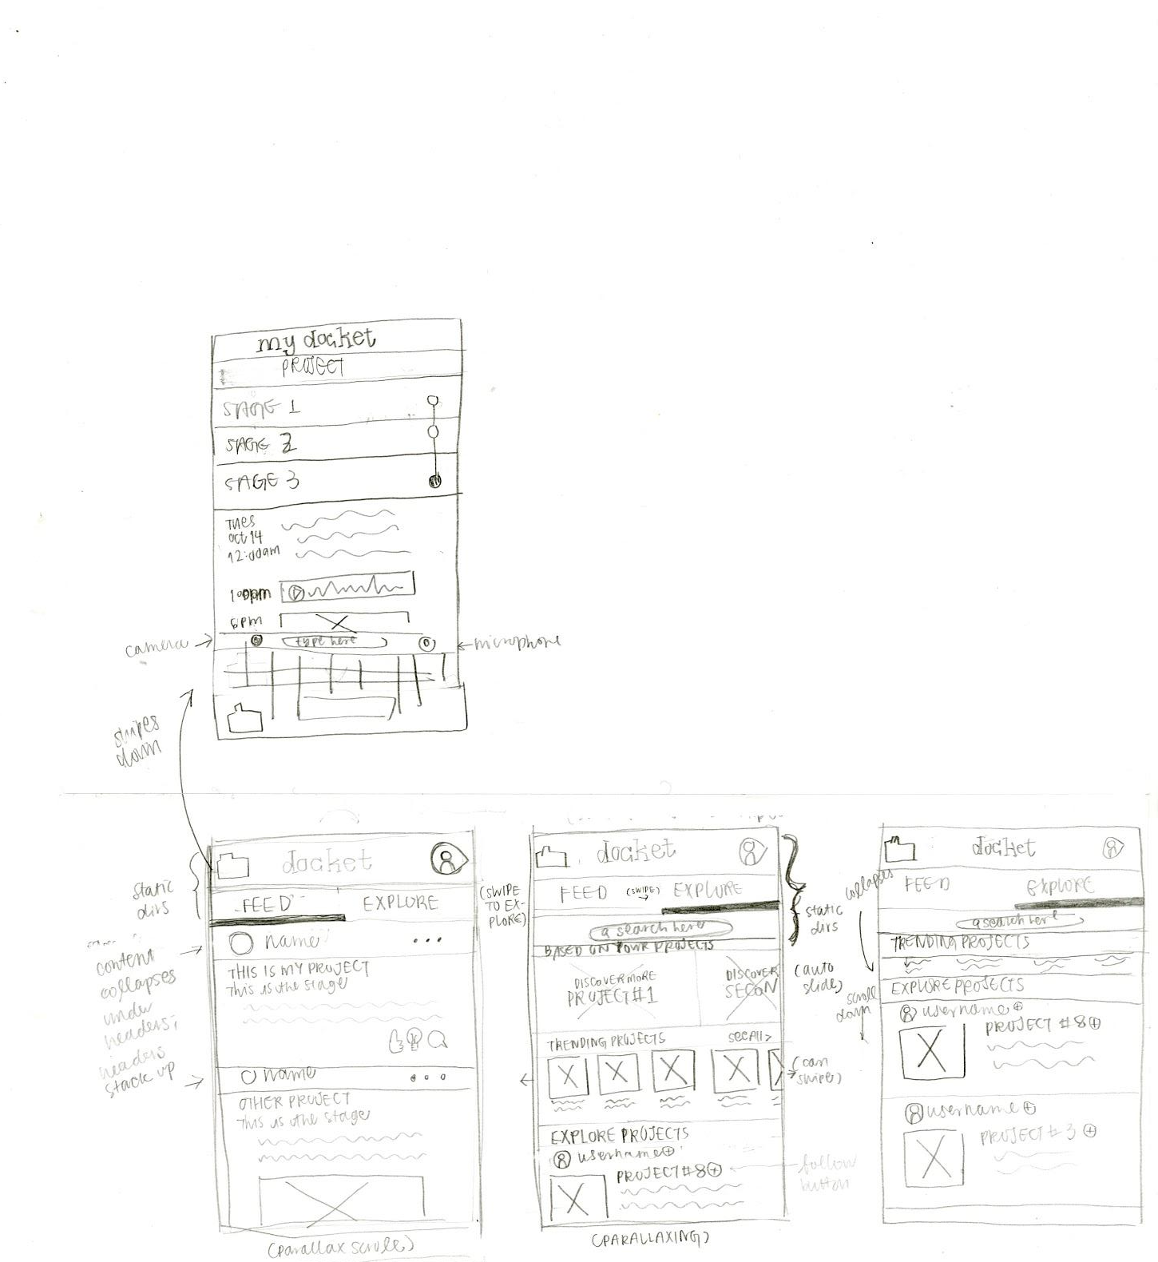
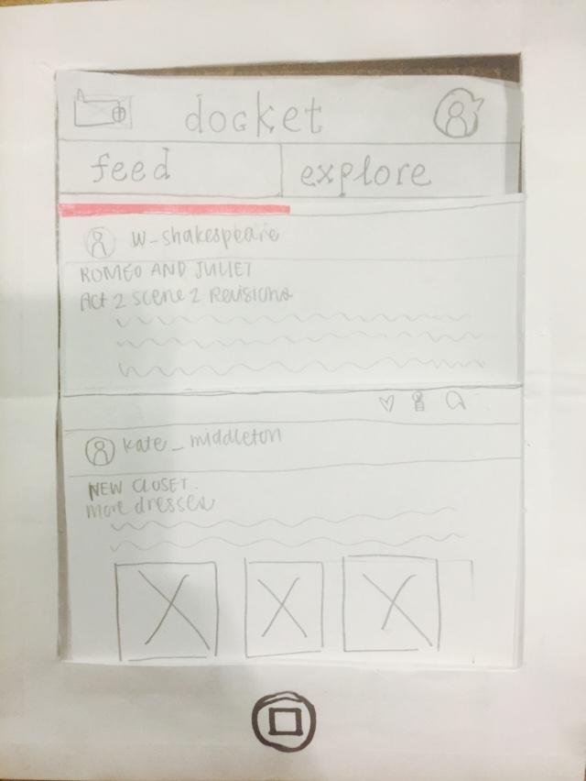
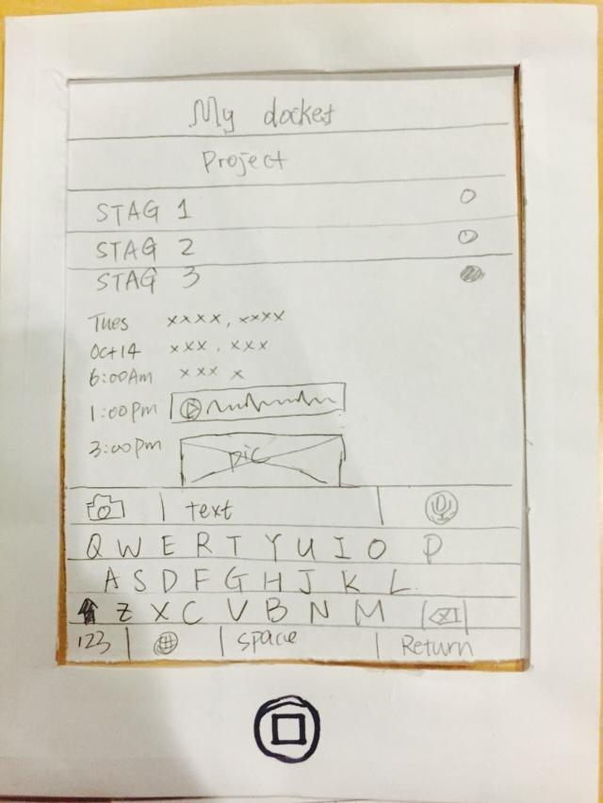
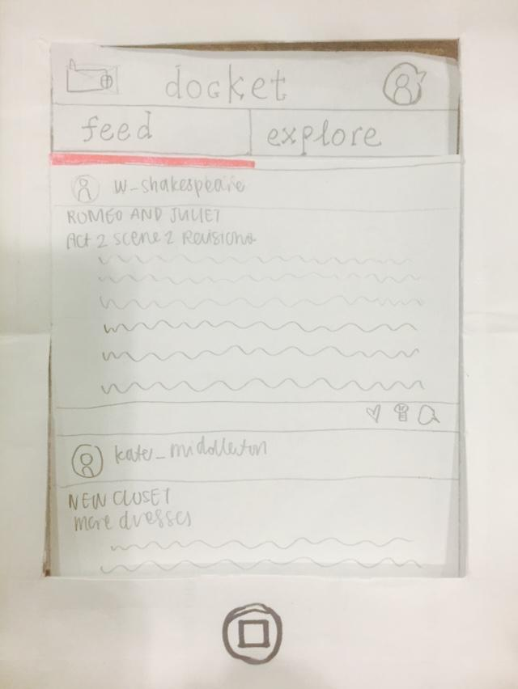
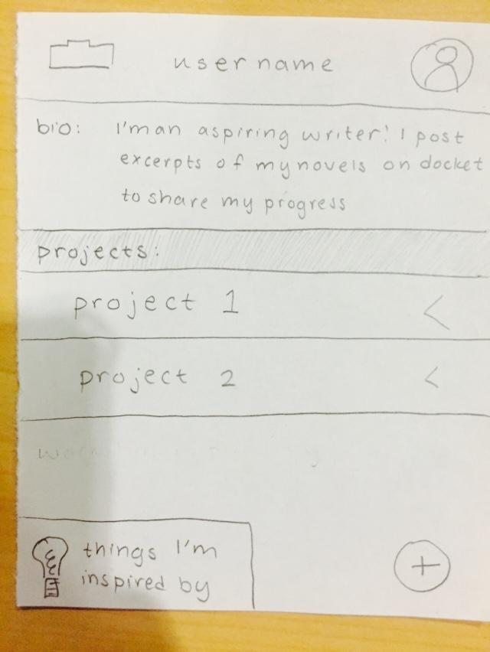
Inspiration
click to expand
click on the explore or swipe left
scroll left and right to explore more projects

Slide 9
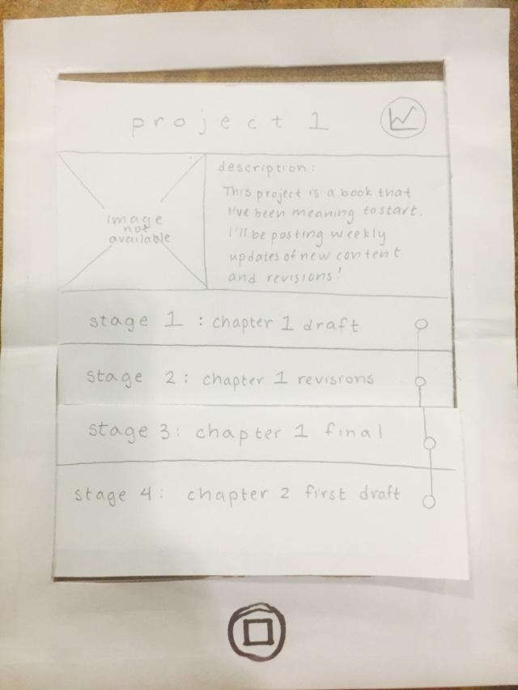
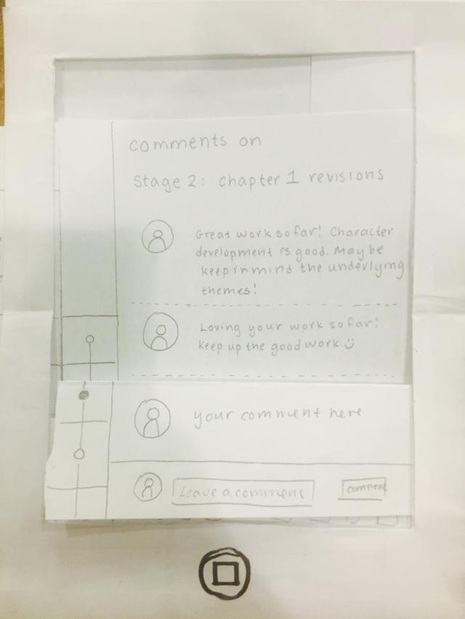
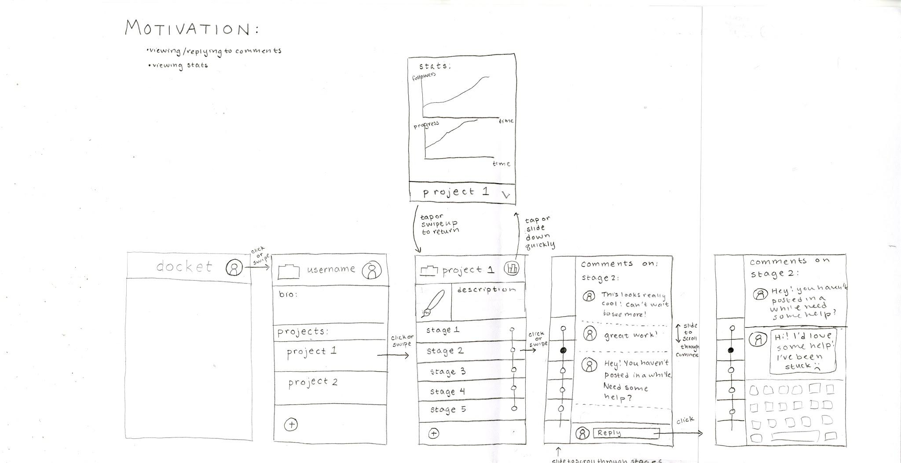
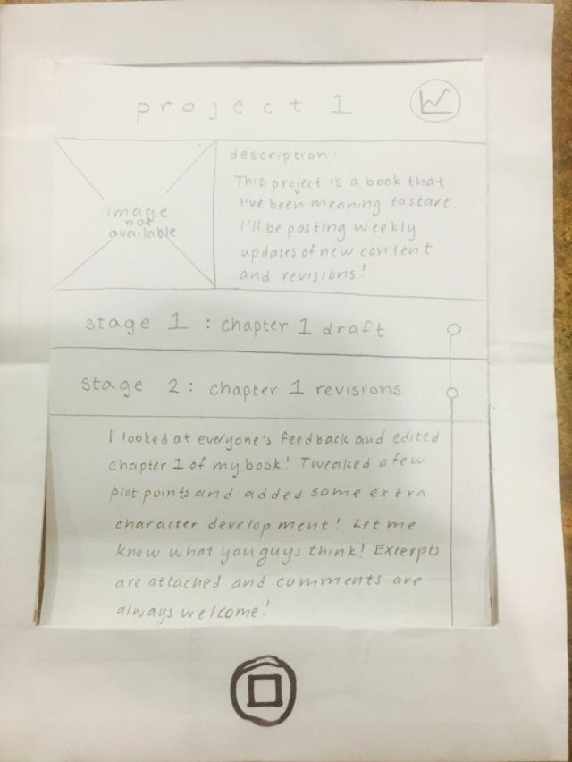
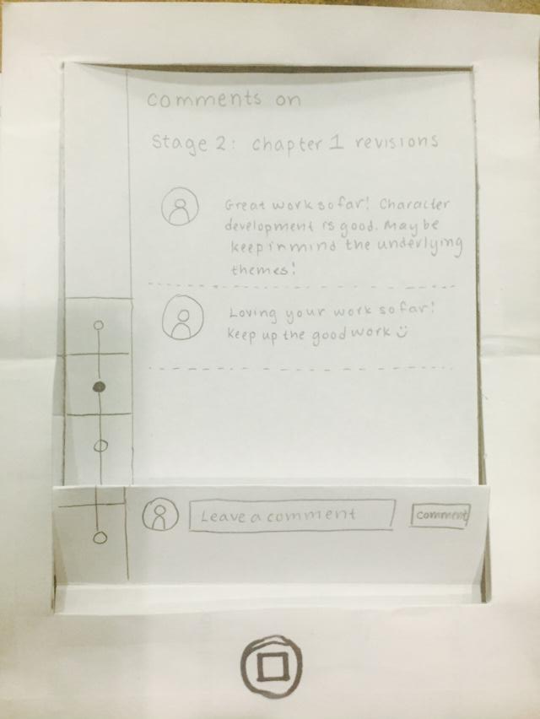
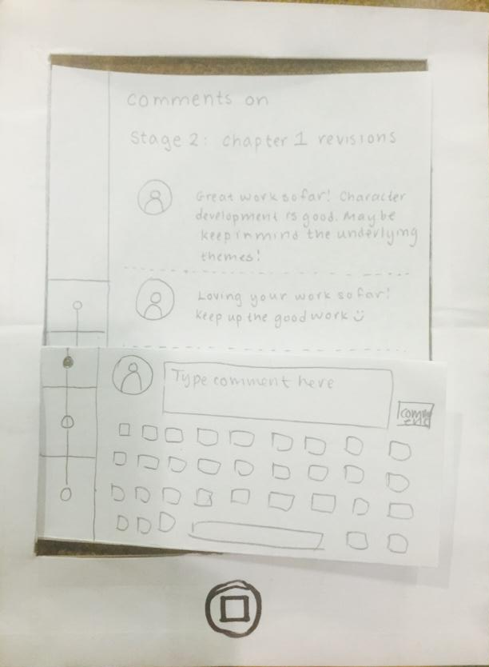
Motivation
click or swipe to get to the detailed project page
click to expand the project detail
click or swipe to check comments

Slide 10
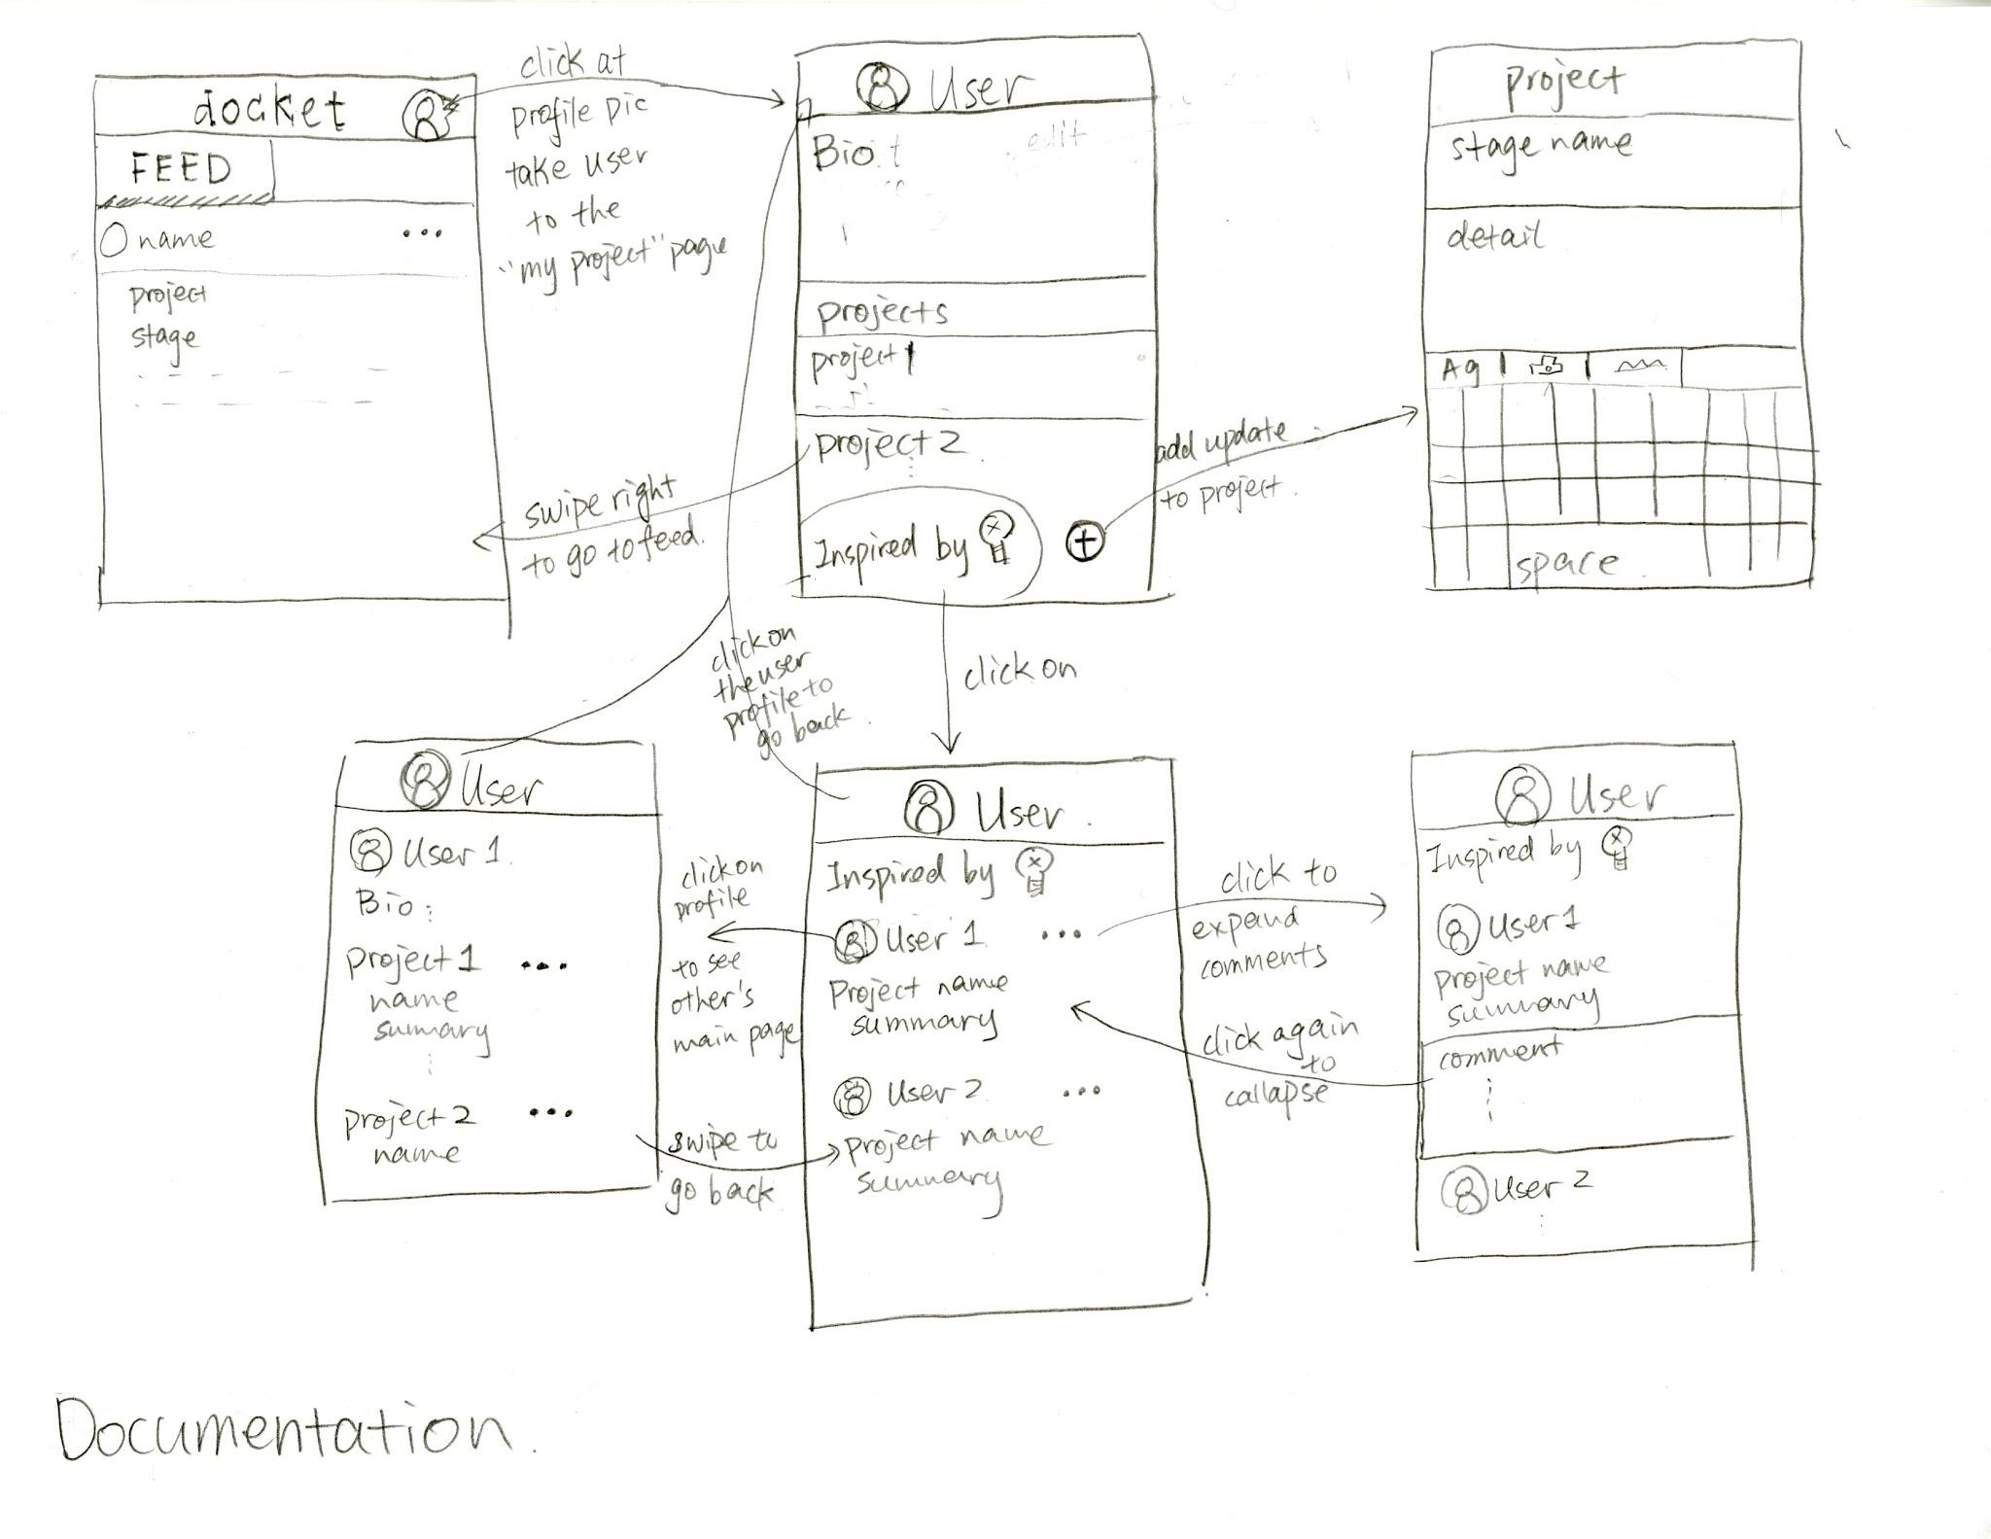
Documentation

Slide 11
Experience Method
Users who were working on their side projects were selected with diverse background
(cs project vs. art project, student vs. working professionals)
The experience was conducted at various places but users all have a empty table with our prototype laid out in front of them, with the frame indicating the screen.
Roles: Irene - smartphone \Jessica - facilitator \Ke - document
Asked users to conduct different tasks and the subtasks
Notes:
Targed users were selected

Slide 12
Experience results
I wish...
Certain icon was not that obvious than we expected

Slide 13

Suggested UI Changes(on docket quicknote)
Icon improvement
location of icon

Slide 14
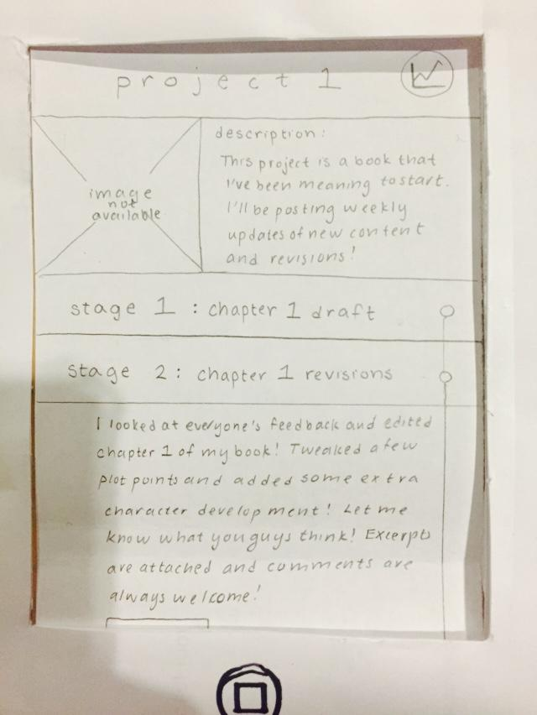
Experience results
I wish...
Users are expecting “back” / “return” button
when we thought they could swipe back
(especially vertical swipe)

Slide 15
Suggested UI Changes
include an explicit return button
Return

Slide 16
Experience results
Finish
I wish...
Users are expecting the “finish” button
when prompt something to enter

Slide 17
Experience results
“Explore” page seems overwhelming

Slide 18
Suggested UI Changes
Instead of the stats, when user holds down on the icon, will be able to see a menu with the names of the different stages, which will be especially helpful if a project has many pages of stages.

Slide 19
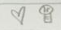
Experience results
I like...
Idea of quick note to myself
vs. update of project
inspired by and like

Slide 20
Summary
－We learned through practice and experiments that: when designing the interface, it is important to consider each step (exit, finish, icon)
－wonder: will user figure out the subtasks that we designed for them by themselves

